Slide 1


Vue.js
This PowerPoint applies to business summary, work report

Slide 2
CONTENTS
01
02
THE TITLE
THE TITLE
Under the blue below the template input title
Under the blue below the template input title
03
04
THE TITLE
THE TITLE
Under the blue below the template input title
Under the blue below the template input title

Slide 3

1 PART
基本知识
As a web designer, I am always looking for awesome photos to include in my designs and mockups. I hate buying stock photos just to use them once.

Slide 4
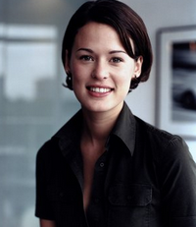



1PART
组件化
模板语法
属性计算
The title content
Free images and videos you can use anywhere. All images and videos on Pixabay
Although, you’re more than welcome to let me know if you use images for a website
If you haven’t found the public domain images you were looking for at Public Domain Archive
Under the blue below the template input title

Slide 5

1PART
组件
组件 (Component) 是 Vue.js 最强大的功能之一。
封装可重用的代码
组件在注册之后，便可以在父实例的模块中以自定义元素 的形式使用
允许我们使用小型、独立和通常可复用的组件构建大型应用。
要确保在初始化根实例之前注册了组件
Although, you’re more than welcome to let me know if you use images for a website. Free images and videos you can use anywhere. All images and videos on Pixabay

Slide 6
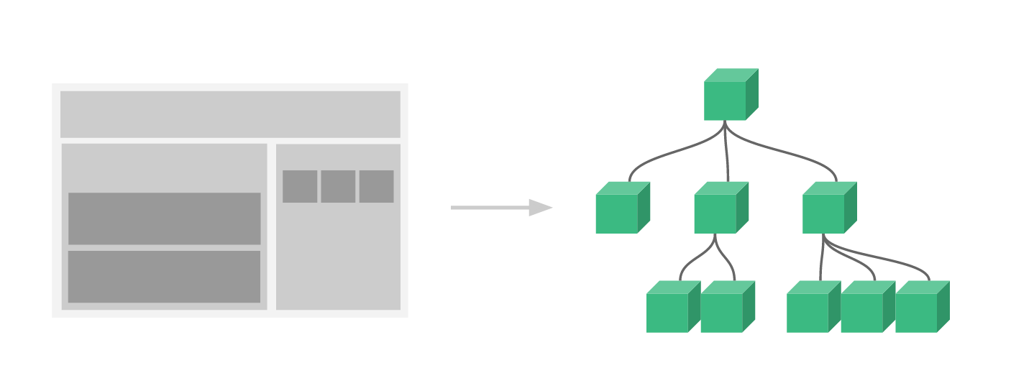
1PART
组件
几乎任意类型的应用界面都可以抽象为一个组件树：
在 Vue 里，一个组件本质上是一个拥有预定义选项的一个 Vue 实例
在一个大型应用中，有必要将整个应用程序划分为组件，以使开发可管理

Slide 7
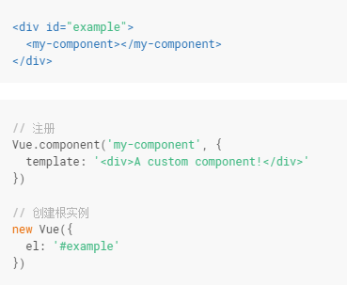
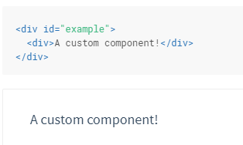
1PART
组件
渲染为

Slide 8
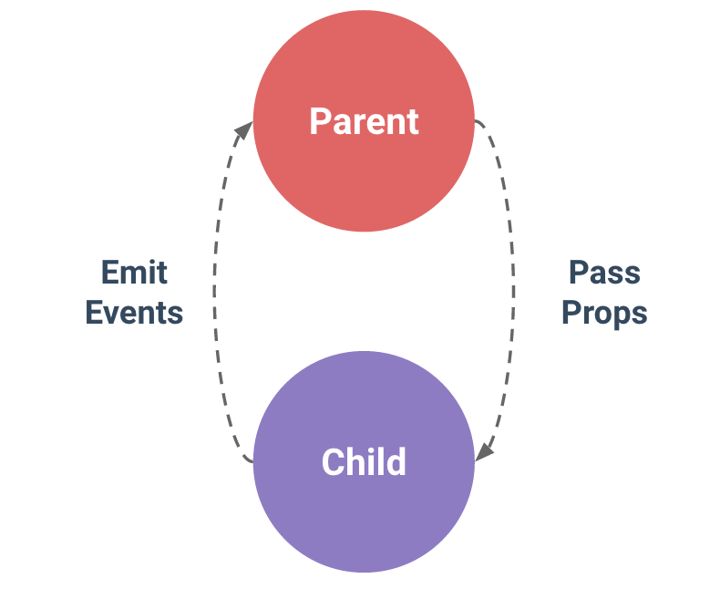
1PART
组件的通信
组件设计初衷就是要配合使用的，最常见的就是形成父子组件的关系：组件 A 在它的模板中使用了组件 B。它们之间必然需要相互通信：父组件可能要给子组件下发数据，子组件则可能要将它内部发生的事情告知父组件。然而，通过一个良好定义的接口来尽可能将父子组件解耦也是很重要的。这保证了每个组件的代码可以在相对隔离的环境中书写和理解，从而提高了其可维护性和复用性。
在 Vue 中，父子组件的关系可以总结为 prop 向下传递，事件向上传递。父组件通过 prop给子组件下发数据，子组件通过事件给父组件发送消息。看看它们是怎么工作的。

Slide 9
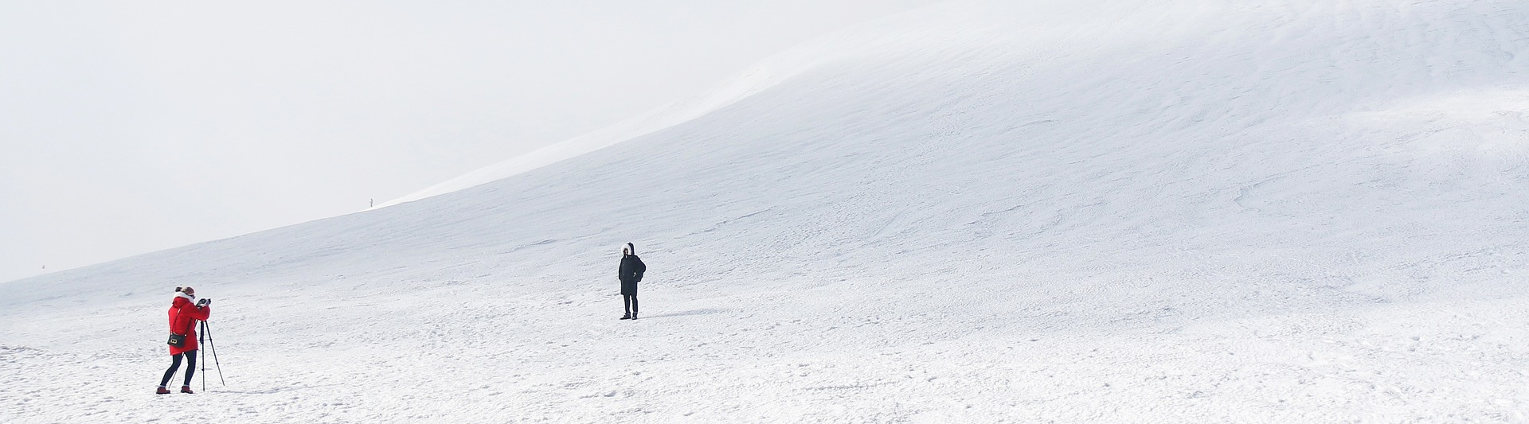
1PART
The title content
As a web designer, I am always looking for awesome photos to include in my designs and mockups. I hate buying stock photos just to use them once.
Title
content
I decided to make a list of some of my favorite sites for free stock photos. If you haven’t found the public domain images you were looking for at Public Domain Archive

Slide 10

1PART
计算属性
当属性有复杂的逻辑，就应该使用计算属性进行计算而不是让模板变得不再简单难以维护

Slide 11

2 PART
进阶
As a web designer, I am always looking for awesome photos to include in my designs and mockups. I hate buying stock photos just to use them once.

Slide 12
YOUR TITLE HERE
HUMANS ARE CREATIVE BEINGS. IF IT IS NOT REAL TEXT, THEY WILL FOCUS ON THE DESIGN.
响应式原理
1
2
服务端渲染
People tend to read writing. This text will not appear in a consistent order.
People tend to read writing. This text will not appear in a consistent order.
路由
3
4
Render函数
People tend to read writing. This text will not appear in a consistent order.
People tend to read writing. This text will not appear in a consistent order.
状态管理
5
6
过渡效果与过渡状态
People tend to read writing. This text will not appear in a consistent order.
People tend to read writing. This text will not appear in a consistent order.

Slide 13
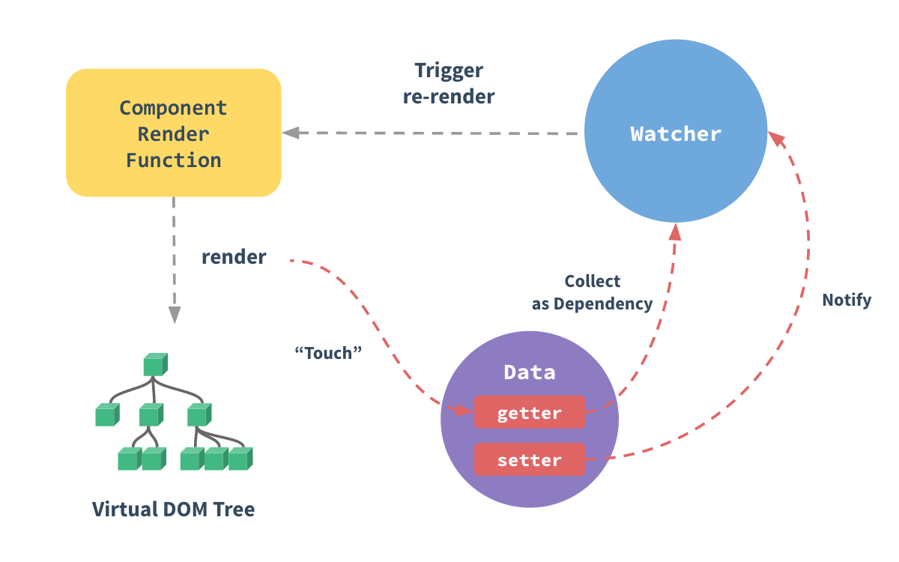

2PART
响应式原理
把一个普通 JavaScript 对象传给 Vue 实例的data选项，Vue 将遍历此对象所有的属性，并使用 Object.defineProperty 把这些属性全部转为 getter/setter。
Vue 最显著的特性之一便是不太引人注意的响应式系统(reactivity system)
我们将开始深入挖掘 Vue 响应式系统的底层细节
用户看不到 getter/setter，但是在内部它们让 Vue 追踪依赖，在属性被访问和修改时通知变化。

Slide 14




2PART
受现代 JavaScript 的限制，Vue 不能检测到对象属性的添加或删除。由于 Vue 会在初始化实例时对属性执行，getter/setter转化过程，所以属性必须在 data对象上存在才能让 Vue 转换它，这样才能让它是响应的。例如：
The title content
Title 01
Title 02
Title 03

Slide 15





2PART
The title content
Under the blue below the template input title
The title
The title
The title
Free images and videos you can use anywhere. All images and videos on Pixabay
If you haven’t found the public domain images you were looking for at Public Domain Archive
Although, you’re more than welcome to let me know if you use images for a website

Slide 16

2PART
The title content
Although, you’re more than welcome to let me know if you use images for a website
As a web designer, I am always looking for awesome photos to include in my designs and mockups. I hate buying stock photos just to use them once.

Slide 17

2PART
Click on the
corresponding input text
TITLE HERE
Although, you’re more than welcome to let me know if you use images for a website.
If you haven’t found the public domain images you were looking for at public domain archive. Free images and videos you can use anywhere.

Slide 18
3 PART
实战介绍
As a web designer, I am always looking for awesome photos to include in my designs and mockups. I hate buying stock photos just to use them once.

Slide 19
3PART
The title content
I decided to make
A list of some of my favorite sites for free stock photos.
If you haven’t found the public domain images you were looking for at public domain archive
Free images and videos you can use anywhere. All images and videos on Pixabay

Slide 20

3PART
The
title content
6
5
4
As a web designer, I am always looking for awesome photos to include in my designs and mockups. I hate buying stock photos just to use them once.
Although, you’re more than welcome to let me know if you use images for a website.
3
2
1
0
TEXT01
TEXT02
TEXT03
TEXT04

Slide 21





3PART
Input
title
content
YOUR TITLE
Under the blue below the template input title
YOUR TITLE
Under the blue below the template input title
If you haven’t found the public domain images you were looking for at public domain archive.
Free images and videos you can use anywhere.
YOUR TITLE
Under the blue below the template input title

Slide 22
3PART
title content
The title content
Although, you’re more than welcome to let me know if you use images for a website
title content
title content
As a web designer, I am always looking for awesome photos to include in my designs and mockups. I hate buying stock photos just to use them once.
title content

Slide 23
3PART
The title content
As a web designer, I am always looking for awesome photos to include in my designs and mockups. I hate buying stock photos just to use them once.
YOUR TITLE
网络请求
YOUR TITLE
YOUR TITLE
If you haven’t found the public domain images you were looking for at public domain archive.
If you haven’t found the public domain images you were looking for at public domain archive.
If you haven’t found the public domain images you were looking for at public domain archive.
If you haven’t found the public domain images you were looking for at public domain archive.

Slide 24
4 PART
如何转化成移动app
As a web designer, I am always looking for awesome photos to include in my designs and mockups. I hate buying stock photos just to use them once.

Slide 25

4PART
和其他框架的差别（待定）
I decided to make a list of some of my favorite sites for free stock photos. If you haven’t found the public domain images you were looking for at Public Domain Archive
Free images and videos

Slide 26

4PART
The title content
As a web designer, I am always looking for awesome photos to include in my designs and mockups. I hate buying stock photos just to use them once.
Under the blue below the template input title
Under the blue below the template input title
Under the blue below the template input title
86%
78%
52%
The title 01
The title 02
The title 03

Slide 27



1PART
THE TITLE
THE TITLE
THE TITLE
在一个大型应用中，有必要将整个应用程序划分为组件，以使开发可管理
Under the blue below the template input title
Under the blue below the template input title
Title
content
几乎任意类型的应用界面都可以抽象为一个组件树：
在 Vue 里，一个组件本质上是一个拥有预定义选项的一个 Vue 实例

Slide 28
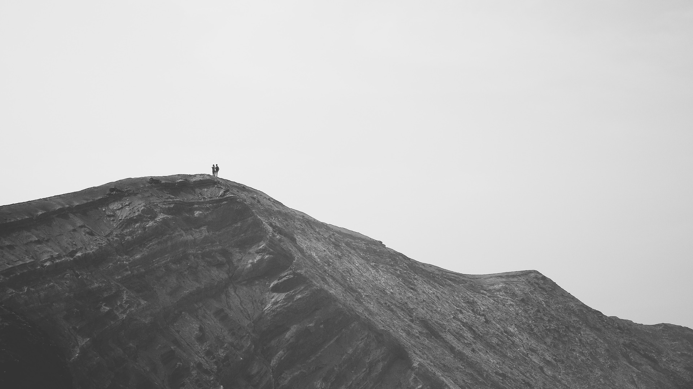



4PART
Title content
Title content
Title content
If you haven’t found the public domain images you were looking for at public domain archive.
If you haven’t found the public domain images you were looking for at public domain archive.
If you haven’t found the public domain images you were looking for at public domain archive.

Slide 29

4PART
The title content
As a web designer, I am always looking for awesome photos to include in my designs and mockups. I hate buying stock photos just to use them once.

Slide 30

4PART
Input
the title content
Although, you’re more than welcome to let me know if you use images for a website
Free images and videos you can use anywhere. All images and videos on Pixabay
Under the blue below the template input title
you were looking for at public domain archive.

Slide 31
THANKS
This PowerPoint applies to business summary, work report
Morning for PPT

Slide 32
更多精品PPT资源尽在—优品PPT！
www.ypppt.com
PPT模板下载：www.ypppt.com/moban/ 节日PPT模板：www.ypppt.com/jieri/
PPT背景图片：www.ypppt.com/beijing/ PPT图表下载：www.ypppt.com/tubiao/
PPT素材下载： www.ypppt.com/sucai/ PPT教程下载：www.ypppt.com/jiaocheng/
字体下载：http://www.ypppt.com/ziti/ 绘本故事PPT：http://www.ypppt.com/gushi/
Notes:
模板来自于 http://www.ypppt.com

